Slide 1
Chapter 10
Distributed Database Management Systems

Slide 2
The Evolution of Distributed Database Management Systems
Distributed database management system (DDBMS)
  Governs storage and processing of logically related data over interconnected computer systems in which both data and processing functions are distributed among several sites

Slide 3
The Evolution of Distributed Database Management Systems (DDBMS)
Centralized database required that corporate data be stored in a single central site
  Performance degradation as number of remote sites grew
  High cost to maintain large centralized DBs
  Reliability problems with one, central site
Dynamic business environment and centralized database’s shortcomings spawned a demand for applications based on data access from different sources at multiple locations
  Business operations became more decentralized geographically
  Competition at global level
  Rapid technological change in computers

Slide 4
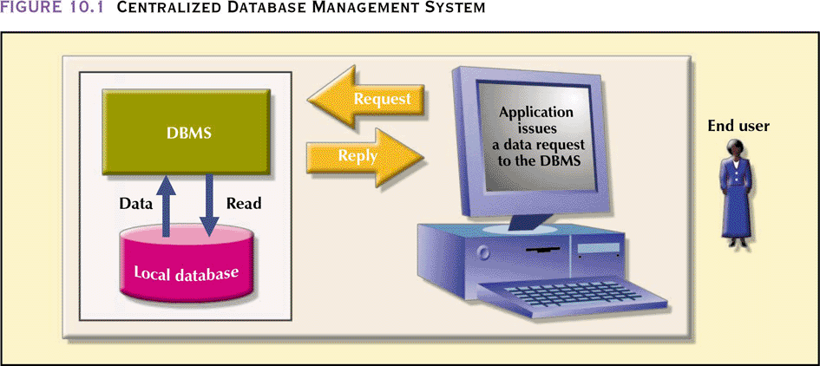
Centralized Database Management System

Slide 5
DDBMS Advantages
Data are located near “greatest demand” site
Faster data access
Faster data processing
Growth facilitation
Improved communications
Reduced operating costs
User-friendly interface
Less danger of a single-point failure
Processor independence

Slide 6
DDBMS Disadvantages
Complexity of management and control
Security
Lack of standards
Increased storage requirements
Greater difficulty in managing the data environment
Increased training cost

Slide 7
Distributed Processing vs
Distributed Database
Distributed processing – a database’s logical processing is shared among two or more physically independent sites that are connected through a network
  One computer performs I/O, data selection and validation while second computer creates reports
  Uses a single-site database but the processing chores are shared among several sites
Distributed database – stores a logically related database over two or more physically independent sites. The sites are connected via a network
  Database is composed of database fragments which are located at different sites and may also be replicated among various sites

Slide 8
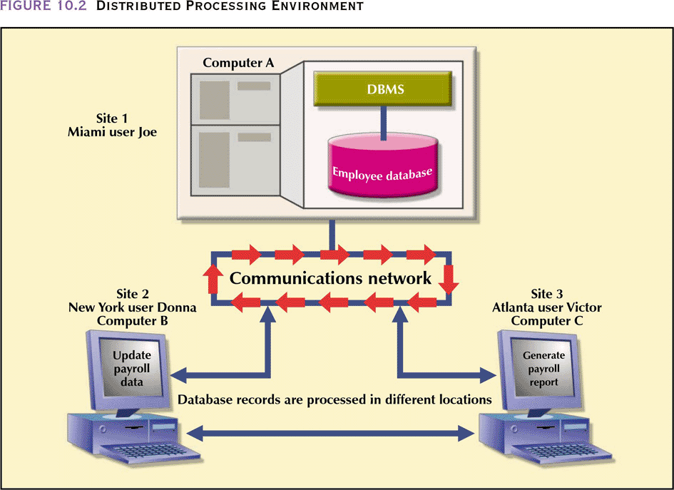
Distributed Processing Environment

Slide 9
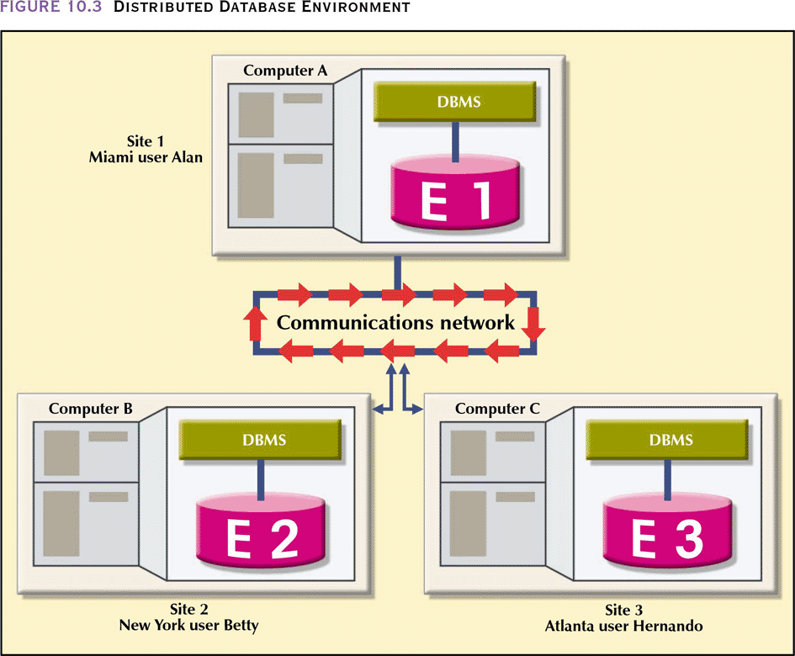
Distributed Database Environment

Slide 10
Characteristics of a DDBMS
Application interface
Validation
Transformation
Query optimization
Mapping
I/O interface
Formatting
Security
Backup and recovery
DB administration
Concurrency control
Transaction management

Slide 11
Characteristics of Distributed Management Systems
Must perform all the functions of a centralized DBMS
Must handle all necessary functions imposed by the distribution of data and processing
Must perform these additional functions transparently to the end user

Slide 12
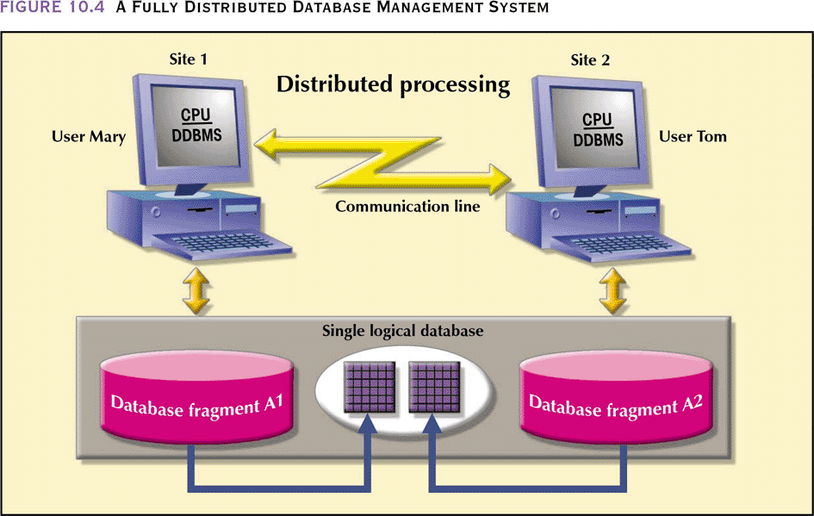
A Fully Distributed Database Management System

Slide 13
DDBMS Components
Must include (at least) the following components:
  Computer workstations
  Network hardware and software
    Allows all sites to interact and exchange data
  Communications media
    Carry the data from one workstation to another
  Transaction processor (application processor or transaction manager)
    Software component found in each computer that receives and processes the application’s requests data
  Data processor or data manager
    Software component residing on each computer that stores and retrieves data located at the site
    May even be a centralized DBMS
    Communications between the TPs and DPs is made possible through a set of protocols used by the DDBMS

Slide 14
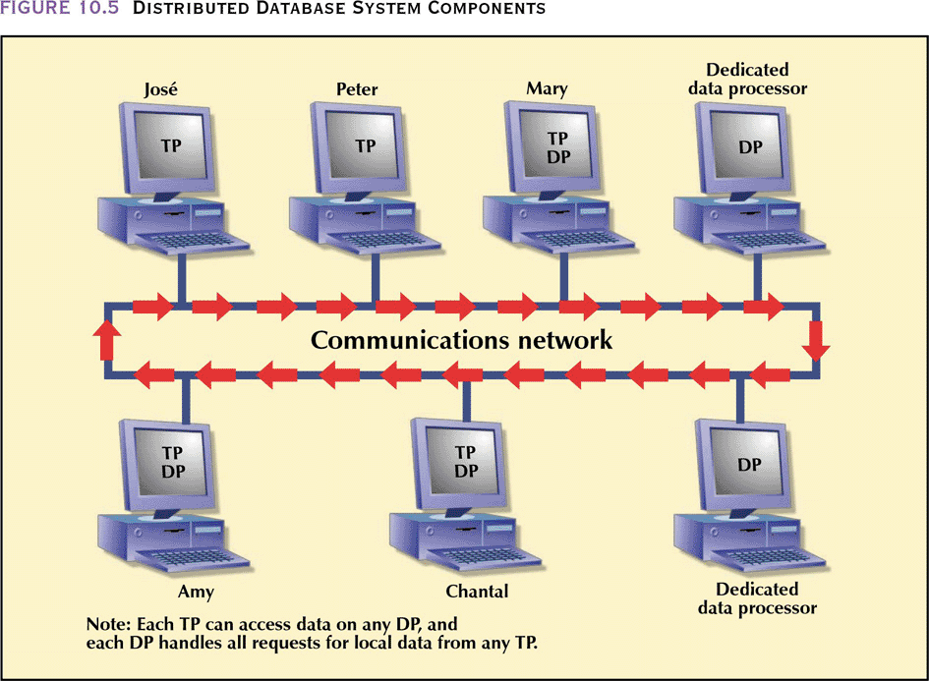
Distributed Database System Components

Slide 15
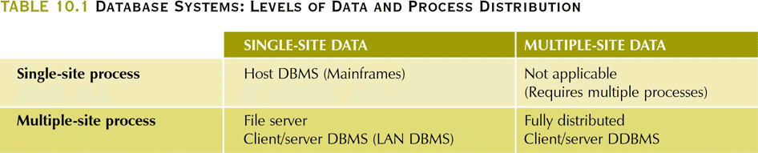
Database Systems: Levels of Data and Process Distribution

Slide 16
Single-Site Processing,
Single-Site Data (SPSD)
All processing is done on single CPU or host computer (mainframe, midrange, or PC)
All data are stored on host computer’s local disk
Processing cannot be done on end user’s side of the system
Typical of most mainframe and midrange computer DBMSs
DBMS is located on the host computer, which is accessed by dumb terminals connected to it
Also typical of the first generation of single-user microcomputer databases

Slide 17
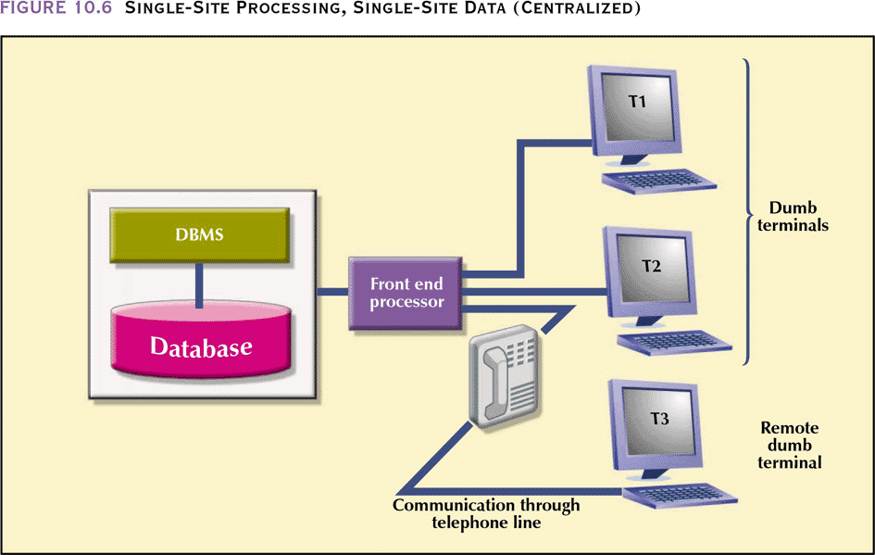
Single-Site Processing, Single-Site Data (Centralized)

Slide 18
Multiple-Site Processing,
Single-Site Data (MPSD)
Multiple processes run on different computers sharing a single data repository
MPSD scenario requires a network file server running conventional applications that are accessed through a LAN
Many multi-user accounting applications, running under a personal computer network, fit such a description

Slide 19
Multiple-Site Processing,
Single-Site Data (MPSD)
TP at each workstation acts only as a redirector to route all network data requests to the file server
All record and file locking activity occurs at the end-user location
All data selection, search and update functions takes place at the workstation. This requires entire files to travel through the network for processing at the workstation. This increases network traffic, slows response time and increases communication costs
  To perform SELECT that results in 50 rows, a 10,000 row table must travel over the network to the end-user

Slide 20
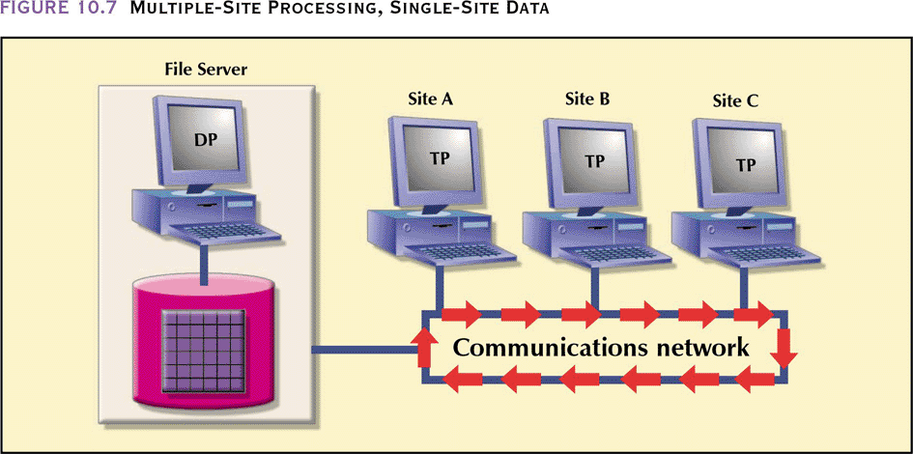
Multiple-Site Processing,
Single-Site Data (MPSD)
In a variation of MPSD known as client/server architecture, all processing occurs at the server site, reducing the network traffic
The processing is distributed; data can be located at multiple sites

Slide 21
Multiple-Site Processing,
Multiple-Site Data (MPMD)
Fully distributed database management system with support for multiple data processors and transaction processors at multiple sites
Classified as either homogeneous or heterogeneous
Homogeneous DDBMSs
  Integrate only one type of centralized DBMS over a network
  The same DBMS will be running on different mainframes, minicomputers and microcomputers
Heterogeneous DDBMSs
  Integrate different types of centralized DBMSs over a network
Fully heterogeneous DDBMS
  Support different DBMSs that may even support different data models (relational, hierarchical, or network) running under different computer systems, such as mainframes and microcomputers
No DDBMS currently provides full support for heterogeneous or fully heterogeneous DDBMSs

Slide 22
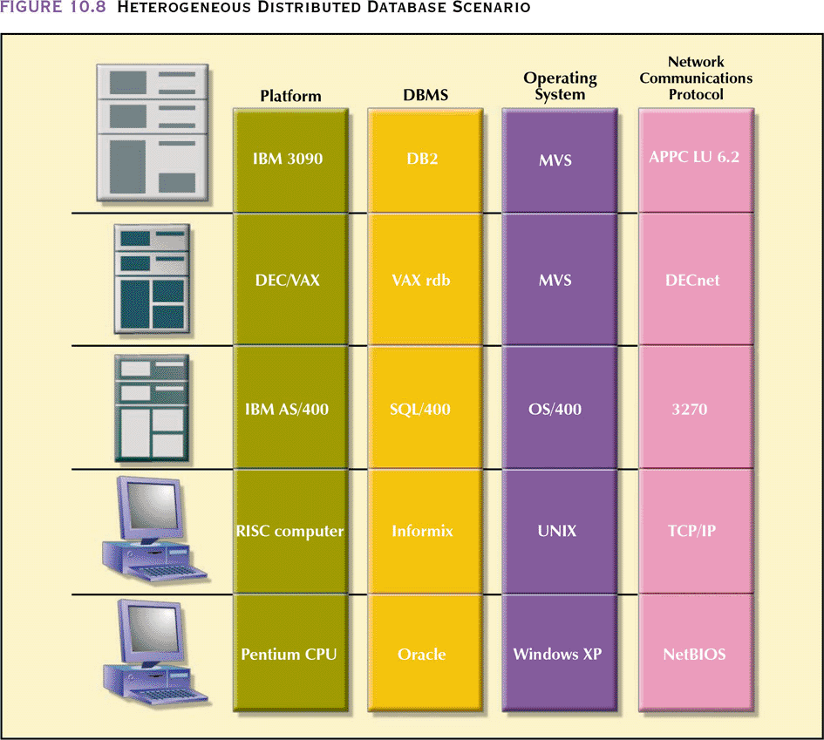
Heterogeneous Distributed
Database Scenario

Slide 23
Distributed Database
Transparency Features
Allow end user to feel like database’s only user. User feels like they are working with a centralized database
Features include:
  Distribution transparency – user does not know where data is located and if replicated or partitioned
  Transaction transparency – transaction can update at several network sites to ensure data integrity

Slide 24
Distributed Database
Transparency Features
  Failure transparency – system continues to operate in the event of a node failure (other nodes pick up lost functionality)
  Performance transparency – allows system to perform as if it were a centralized DBMS. No performance degradation due to use of a network or platform differences
  Heterogeneity transparency – allows the integration of several different local DBMSs under a common schema

Slide 25
Distribution Transparency
Allows management of a physically dispersed database as though it were a centralized database
Supported by a distributed data dictionary (DDD) which contains the description of the entire database as seen by the DBA
  The DDD is itself distributed and replicated at the network nodes
Three levels of distribution transparency are recognized:
  Fragmentation transparency – user does not need to know if a database is partitioned; fragment names and/or fragment locations are not needed
  Location transparency – fragment name, but not location, is required
  Local mapping transparency – user must specify fragment name and location

Slide 26
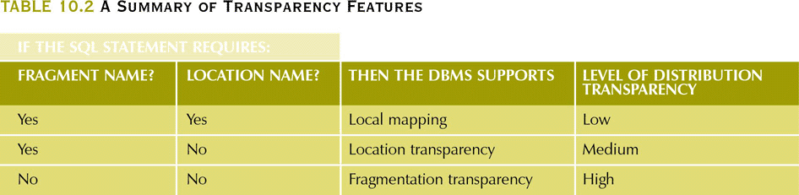
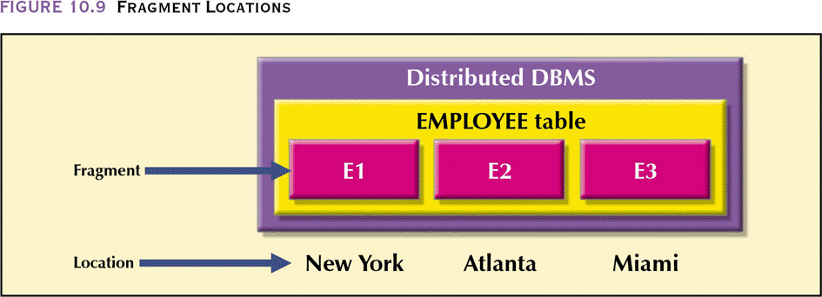
A Summary of Transparency Features

Slide 27
Distribution Transparency
The EMPLOYEE table is divided among three locations (no replication)
Suppose an employee wants to find all employees with a birthdate prior to jan 1, 1940
  Fragmentation transparency-
    SELECT * FROM EMPLOYEE WHERE EMP_DOB < ’01-JAN-1940’;
  Location transparency-
    SELECT * FROM E1 WHERE EMP_DOB < ’01-JAN-1940’ UNION SELECT * FROM E2 … UNION SELECT * FROM E3…;
  Local Mapping Transparency
    SELECT * FROM E1 NODE NY WHERE EMP_DOB < ’01-JAN-1940’ UNION SELECT * FROM E2 NODE ATL … UNION SELECT * FROM E3 NODE MIA…;

Slide 28
Transaction Transparency
Ensures database transactions will maintain distributed database’s integrity and consistency
A DDBMS transaction can update data stored in many different computers connected in a network
  Transaction transparency ensures that the transaction will be completed only if all database sites involved in the transaction complete their part of the transaction

Slide 29
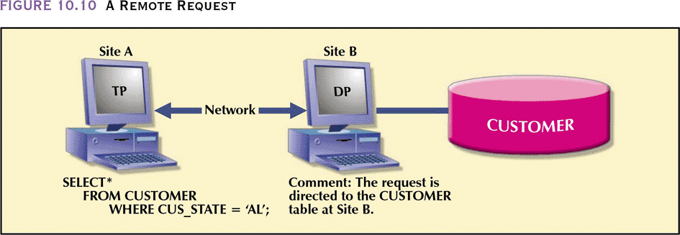
A Remote Request
Remote request
  Lets a single SQL statement access data to be processed by a single remote database processor i.e., the SQL statement can reference data at only one remote site

Slide 30
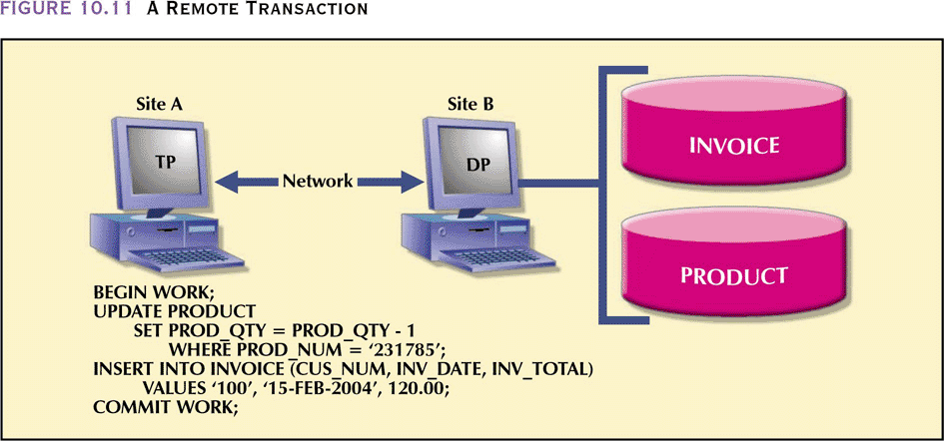
A Remote Transaction
Remote transaction
  Accesses data at a single remote site
  This transaction updates two tables
  The remote transaction is sent to and executed at remote site B
  The transaction can reference only one remote DP
  Each SQL statement can reference only one remote DP at a time, and the entire transaction can reference and can be executed at only one remote DP

Slide 31
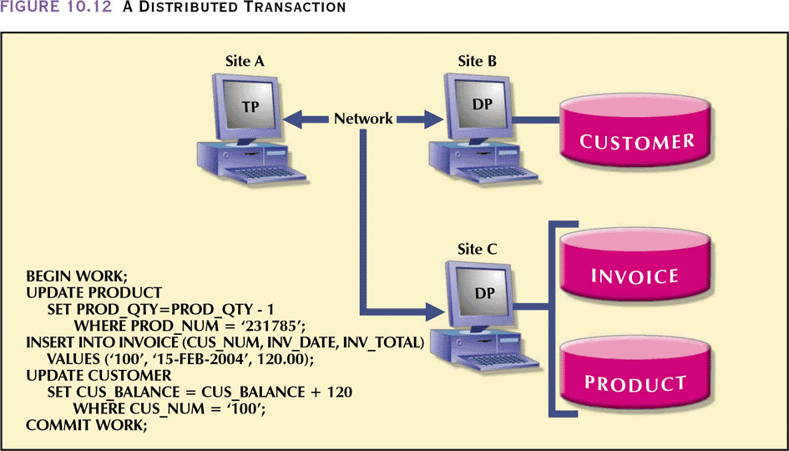
A Distributed Transaction
Distributed transaction
  Allows a transaction to reference several different (local or remote) DP sites
  Each request can access only one remote site at a time
    Does not support access to a table fragmented across multiple remote sites in one request

Slide 32
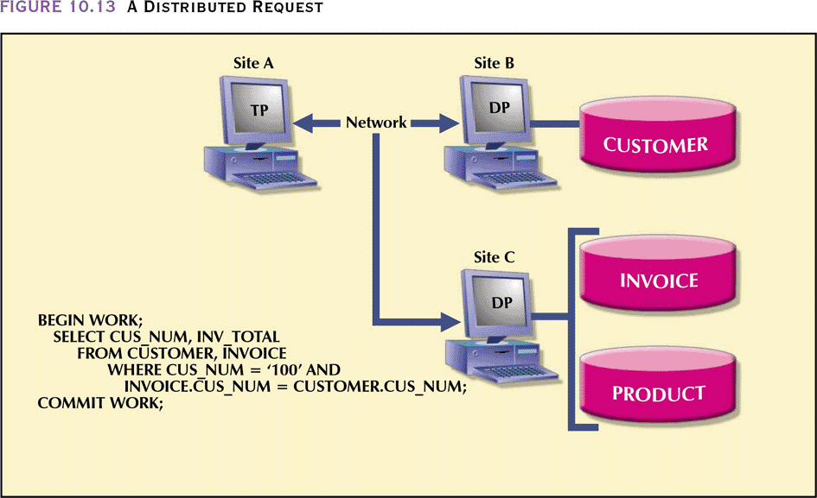
A Distributed Request
Distributed request
  Lets a single SQL statement reference data located at several different local or remote DP sites
    The SELECT statement references two tables that are located at two different sites
  Similarly, a table fragmented across two sites can be transparently queried in one SELECT (next slide)

Slide 33
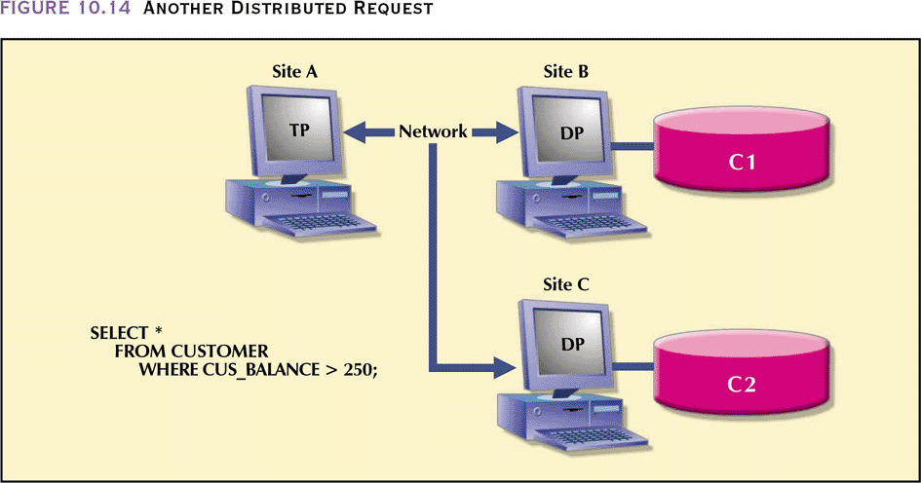
Another Distributed Request

Slide 34
Distributed Concurrency Control
Multisite, multiple-process operations are much more likely to create data inconsistencies and deadlocked transactions than are single-site systems
The TP component of a DDBMS must ensure that all parts of the transaction, at all sites, are completed before a final COMMIT is issued to record the transaction

Slide 35
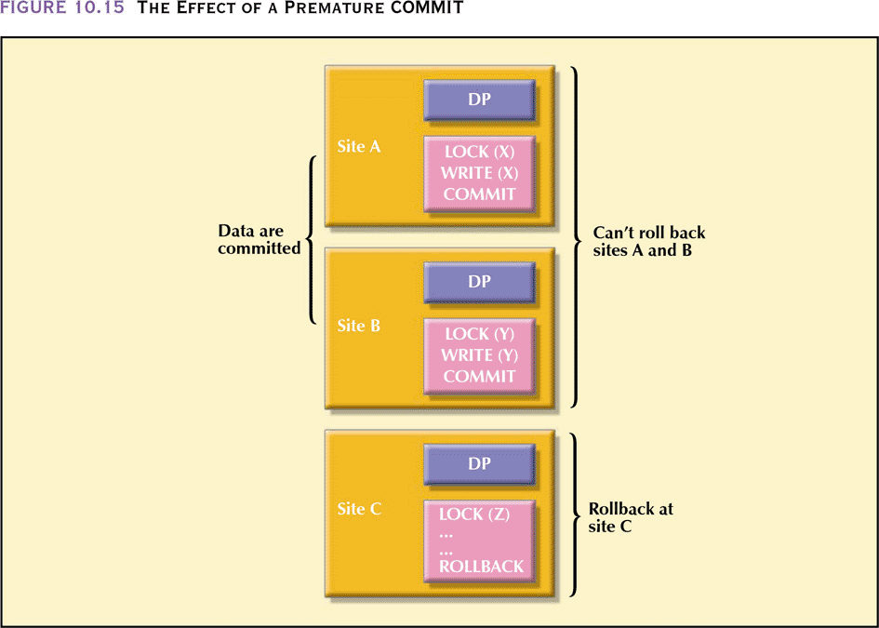
The Effect of a Premature COMMIT
If one of the DPs did not commit and had to rollback while the other sites committed, the database would not be in a consistent state

Slide 36
Two-Phase Commit Protocol
Distributed databases make it possible for a transaction to access data at several sites
Final COMMIT must not be issued until all sites have committed their parts of the transaction
Two-phase commit protocol requires each individual DP’s transaction log entry be written before the database fragment is actually updated

Slide 37
Two-Phase Commit Protocol
DO-UNDO-REDO protocol is used by the DP to roll back and/or roll forward transactions with the help of the system’s transaction log entries
  DO performs the operation and records the “before” and “after” values in the transaction log
  UNDO reverses an operation, using the log entries written by the DO portion of the sequence
  REDO redoes an operation, using the log entries written by the DO portion of the sequence
  To ensure that the DO,UNDO and REDO operations can survive a system crash while they are being executed, a write-ahead protocol is used
    This forces the log entry to be written to permanent storage before the actual operation takes place

Slide 38
Two-Phase Commit Protocol
The two-phase commit protocol defines the operations between two types of nodes – the coordinator and one or more subordinates
Phase I: Preparation
  The coordinator sends a PREPARE TO COMMIT message to its subordinates
  The subordinates receive the message, write the transaction log using the write-ahead protocol, and send an acknowledgement (YES/PREPARED TO COMMIT or NO/NOT PREPARED) message to the coordinator
  The coordinator makes sure that all nodes are ready to commit or it aborts the action

Slide 39
Two-Phase Commit Protocol
Phase II: The Final COMMIT
  The coordinator broadcasts a COMMIT message to all subordinates and waits for replies
  Each subordinate receives the COMMIT message, then updates the database using the DO protocol
  The subordinates reply with a COMMITTED or NOT COMMITTED message to the coordinator
  If one or more subordinates did not commit, the coordinator sends an ABORT message, forcing them to UNDO all changes
    The information necessary to recover the database is in the transaction log and the database can be recovered with the DO-UNDO-REDO protocol

Slide 40
Distributed Database Design
Data fragmentation:
  How to partition the database into fragments
Data replication:
  Which fragments to replicate
Data allocation:
  Where to locate those fragments and replicas

Slide 41
Data Fragmentation
Breaks single object into two or more segments or fragments
Each fragment can be stored at any site over a computer network
Information about data fragmentation is stored in the distributed data catalog (DDC), from which it is accessed by the TP to process user requests

Slide 42
Data Fragmentation Strategies
Horizontal fragmentation:
  Division of a relation into subsets (fragments) of tuples (rows)
Vertical fragmentation:
  Division of a relation into attribute (column) subsets
Mixed fragmentation:
  Combination of horizontal and vertical strategies

Slide 43
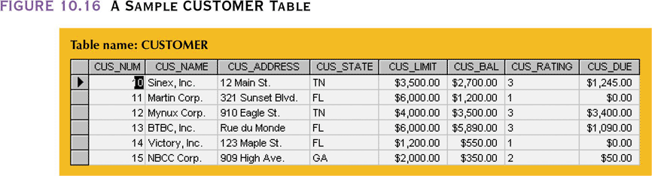
A Sample CUSTOMER Table

Slide 44
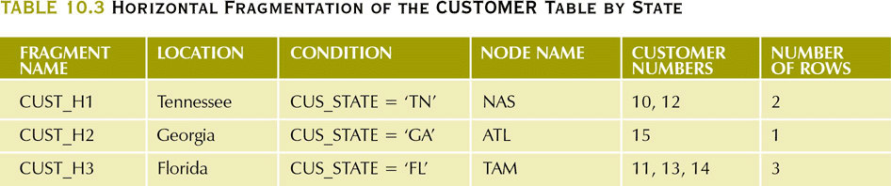
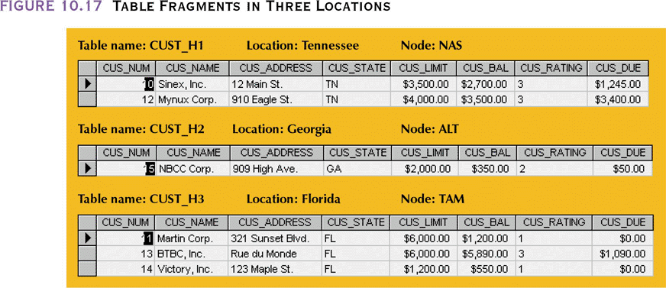
Horizontal Fragmentation of the CUSTOMER Table by State

Slide 45
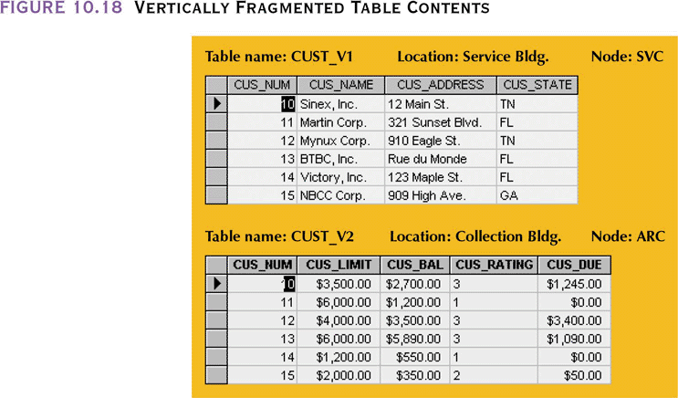
Vertically Fragmented Table Contents
Two separate areas in the company use different fields of the table in the daily activities – the SERVICE dept and the COLLECTIONS dept

Slide 46
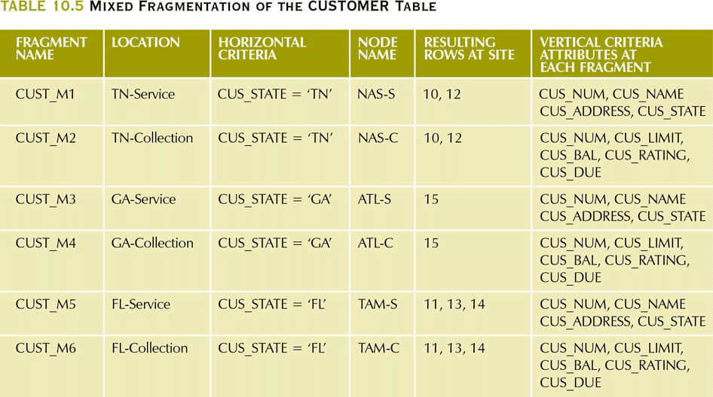
Mixed Fragmentation of the
CUSTOMER Table
The table is divided horizontally by the three states and within each state there is a vertical fragmentation by department

Slide 47
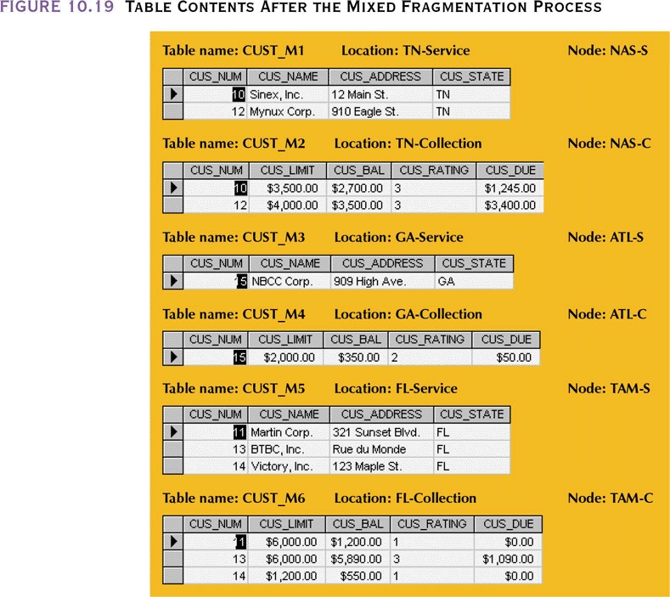
Table Contents After the Mixed Fragmentation Process

Slide 48
Data Replication
Storage of data copies at multiple sites served by a computer network
Fragment copies can be stored at several sites to serve specific information requirements
  Can enhance data availability and response time
  Can help to reduce communication and total query costs
  Imposes additional processing overhead
    Which copy do you read when submitting a query
    All copies must be updated when a write occurs

Slide 49
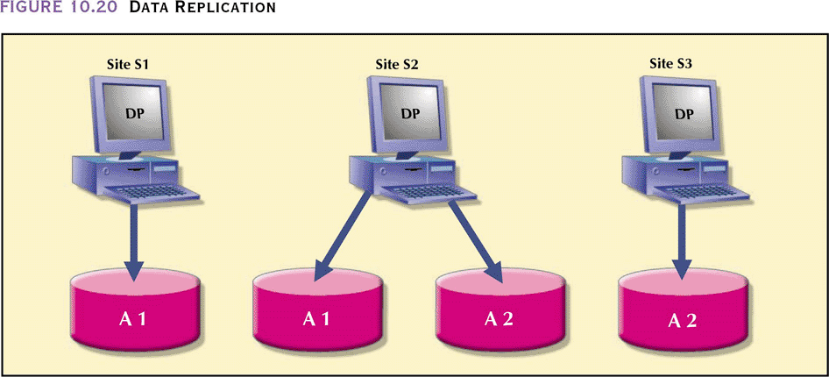
Data Replication

Slide 50
Replication Scenarios
Fully replicated database:
  Stores multiple copies of each database fragment at multiple sites
  Can be impractical due to amount of overhead
Partially replicated database:
  Stores multiple copies of some database fragments at multiple sites
  Most DDBMSs are able to handle the partially replicated database well
Unreplicated database:
  Stores each database fragment at a single site
  No duplicate database fragments
  Database size, usage frequency and costs (performance, overhead, management) influence the decision to replicate

Slide 51
Data Allocation
Deciding where to locate data
Allocation strategies:
  Centralized data allocation
    Entire database is stored at one site
  Partitioned data allocation
    Database is divided into several disjointed parts (fragments) and stored at several sites
  Replicated data allocation
    Copies of one or more database fragments are stored at several sites
Data distribution over a computer network is achieved through data partition, data replication, or a combination of both

Slide 52
Client/Server vs. DDBMS
Way in which computers interact to form a system
Features a user of resources, or a client, and a provider of resources, or a server
Can be used to implement a DBMS in which the client is the TP and the server is the DP
  The client interacts with the end user and sends a request to the server.
  The server receives, schedules and executes the request, selecting only those records that are needed by the client.
  The server sends the data to the client only when the client requests the data.

Slide 53
Client/Server Advantages
Less expensive than alternate minicomputer or mainframe solutions
Allow end user to use microcomputer’s GUI, thereby improving functionality and simplicity
More people with PC skills than with mainframe skills in the job market
PC is well established in the workplace
Numerous data analysis and query tools exist to facilitate interaction with DBMSs available in the PC market
Considerable cost advantage to offloading applications development from the mainframe to powerful PCs

Slide 54
Client/Server Disadvantages
Creates a more complex environment, in which different platforms (LANs, operating systems, and so on) are often difficult to manage
An increase in the number of users and processing sites often paves the way for security problems
Possible to spread data access to a much wider circle of users→ increases demand for people with broad knowledge of computers and software→ increases burden of training and cost of maintaining the environment

Slide 55
C. J. Date’s Twelve Commandments for Distributed Databases
Local site independence
Central site independence
Failure independence
Location transparency
Fragmentation transparency
Replication transparency
Distributed query processing
Distributed transaction processing
Hardware independence
Operating system independence
Network independence
Database independence

